Slide 1
Access Control Lists
Configuring and Troubleshooting ACLs

Slide 2
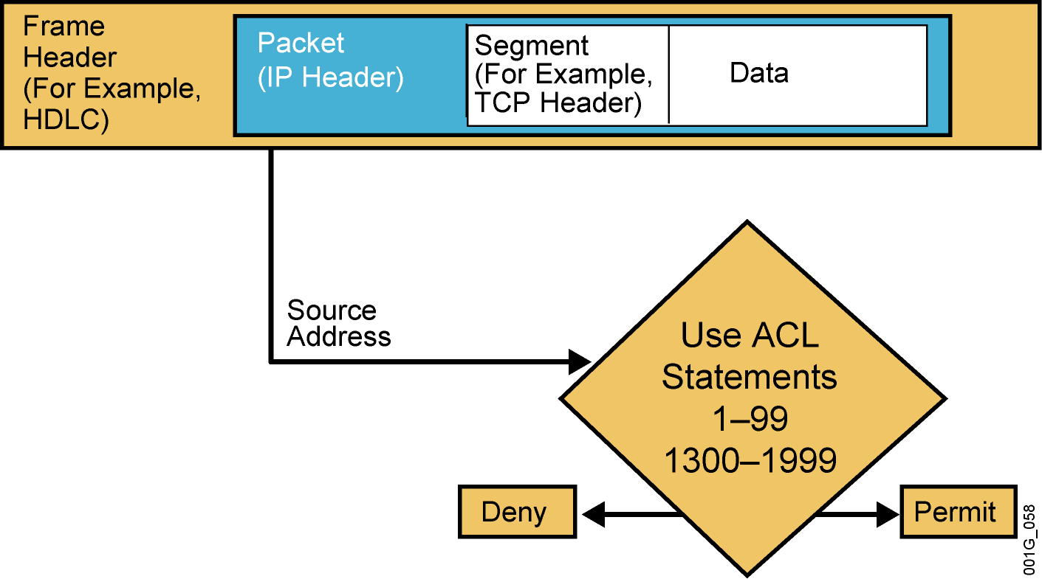
Testing Packets with
Numbered Standard IPv4 ACLs
Notes:
Purpose: This graphic gives an overview of the type of TCP/IP packet tests that standard access lists can filter. It uses the encapsulation graphic and diamond decision graphic to remind students of material presented earlier in this course.

Slide 3
Numbered Standard IPv4 ACL Configuration
RouterX(config)#
access-list access-list-number
{permit | deny | remark} source [mask]
Uses 1 to 99 for the access-list-number.
The first entry is assigned a sequence number of 10, and successive entries
are incremented by 10.
Default wildcard mask is 0.0.0.0 (only standard ACL).
no access-list access-list-number removes the entire ACL.
remark lets you add a description to the ACL.
RouterX(config-if)#
ip access-group access-list-number {in | out}
Activates the list on an interface.
Sets inbound or outbound testing.
no ip access-group access-list-number {in | out} removes the ACL from the interface.
Notes:
Layer 2 of 2
Purpose: This layer shows the ip access-group command.
Emphasize: The ip access-group command links an access list to an interface. Only one access list per interface, per direction, per protocol is allowed.
The ip access-group field descriptions are as follows:
list—Number of the access list to be linked to this interface.
direction—Default is outbound.
Note: Create the access list first before applying it to the interface. If it is applied to the interface before it is created, the action will be to permit all traffic. However, as soon as you create the first statement in the access list, the access list will be active on the interface. Since there is the implicit deny all at the end of every access list, the access list may cause most traffic to be blocked on the interface.
To remove an access list, remove it from all the interfaces first, then remove the access list. In older versions of Cisco IOS, removing the access list without removing it from the interface can cause problems.

Slide 4
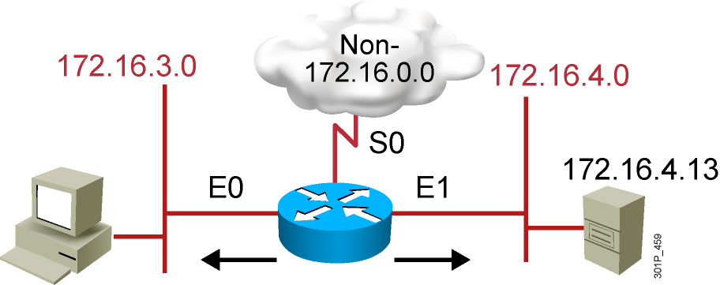
Numbered Standard IPv4 ACL
Example 1
RouterX(config)# access-list 1 permit 172.16.0.0 0.0.255.255
(implicit deny all - not visible in the list)
(access-list 1 deny 0.0.0.0 255.255.255.255)
RouterX(config)# interface ethernet 0
RouterX(config-if)# ip access-group 1 out
RouterX(config)# interface ethernet 1
RouterX(config-if)# ip access-group 1 out
Permit my network only
Notes:
Layer 2 of 2
Emphasize: Because of the implicit deny all, all non-172.16.x.x traffic is blocked going out E0 and E1.
Note: The red arrows represent the access list is applied as an outbound access list.

Slide 5
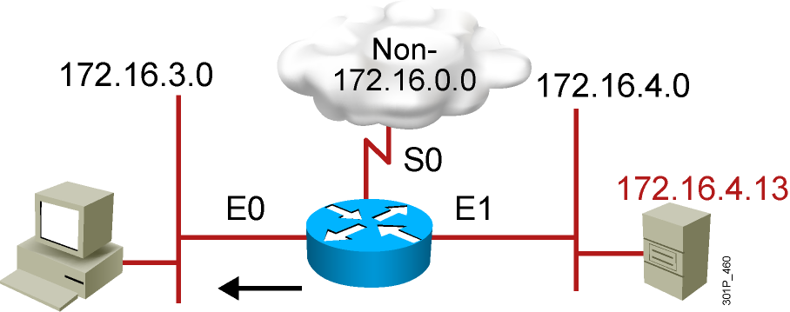
Numbered Standard IPv4 ACL
Example 2
RouterX(config)# access-list 1 deny 172.16.4.13 0.0.0.0
RouterX(config)# access-list 1 permit 0.0.0.0 255.255.255.255
(implicit deny all)
(access-list 1 deny 0.0.0.0 255.255.255.255)
RouterX(config)# interface ethernet 0
RouterX(config-if)# ip access-group 1 out
Deny a specific host
Notes:
Layer 3 of 3
Emphasize: Only host 172.16.4.13 is blocked from going out on E0 to subnet 172.16.3.0.
Ask the students what will happen if the access list is placed as an input access list on E1 instead. Host 172.16.4.13 will be blocked from going out to the non-172.16.0.0 cloud, as well as to subnet 172.16.3.0.
Note: The red arrows represent the access list is applied as an outbound access list.

Slide 6
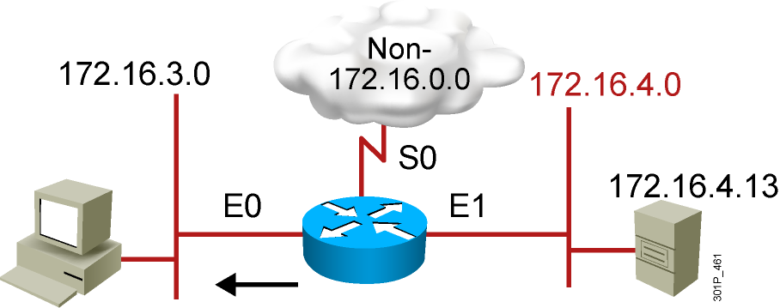
Numbered Standard IPv4 ACL
Example 3
RouterX(config)# access-list 1 deny 172.16.4.0 0.0.0.255
RouterX(config)# access-list 1 permit any
(implicit deny all)
(access-list 1 deny 0.0.0.0 255.255.255.255)
RouterX(config)# interface ethernet 0
RouterX(config-if)# ip access-group 1 out
Deny a specific subnet
Notes:
Layer 2 of 2
Emphasize: All hosts on subnet 172.16.4.0 are blocked from going out on E0 to subnet 172.16.3.0.
Note: The red arrows represent the access list is applied as an outbound access list.

Slide 7
Standard ACLs to Control vty Access
RouterX(config-line)#
access-class access-list-number {in | out}
Restricts incoming or outgoing connections between a particular
vty and the addresses in an ACL
Example:
access-list 12 permit 192.168.1.0 0.0.0.255
(implicit deny any)
!
line vty 0 4
access-class 12 in
Permits only hosts in network 192.168.1.0 0.0.0.255 to connect
to the router vty lines
Notes:
Purpose: This example shows how to restrict incoming Telnet sessions to the router’s vty ports.
Emphasize: The access class is applied as an input filter.
Note: Ask the student about the effect of changing the direction of the access class to outbound instead of inbound.
Now the router can accept incoming Telnet sessions to its vty ports from all hosts, but will block outgoing Telnet sessions from its vty ports to all hosts except hosts in network 192.89.55.0.
Once a user is Telneted into a router’s vty port, the outbound access-class filter will prevent the user from Telneting to other hosts as specified by the standard access list.
Remember, when an access list is applied to an interface, it only blocks or permits traffic going through the router, it does not block or permit traffic initiated from the router itself.

Slide 8
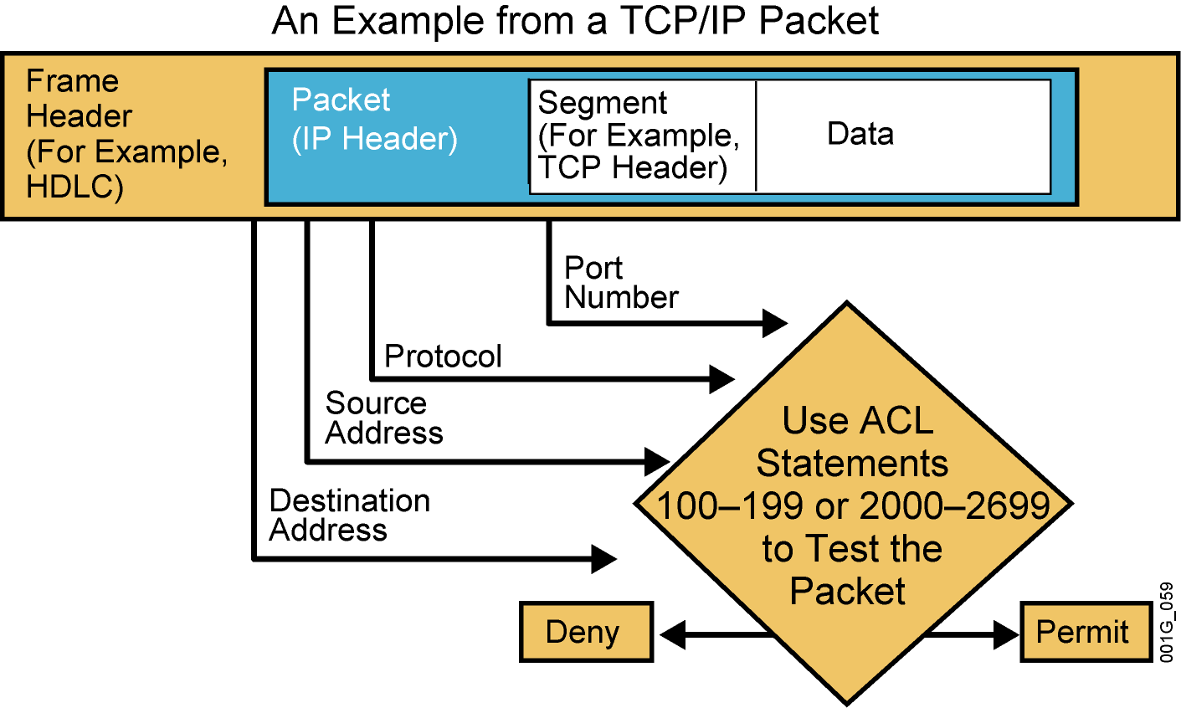
Testing Packets with
Numbered Extended IPv4 ACLs
Notes:
Purpose: This graphic gives an overview of the type of TCP/IP packet tests that extended access lists can filter. It uses the encapsulation graphic and diamond decision graphic to remind students of material presented earlier in this course.

Slide 9
Numbered Extended IPv4 ACL Configuration
RouterX(config)#
access-list access-list-number {permit | deny}
protocol source source-wildcard [operator port]
destination destination-wildcard [operator port]
[established] [log]
Sets parameters for this list entry
RouterX(config-if)#
ip access-group access-list-number {in | out}
Activates the extended list on an interface
Notes:
Layer 2 of 2
Purpose: Layer 2—Adds the access-group command for IP.
Emphasize: The list number must match the number (100 to 199) you specified in the access-list command.

Slide 10
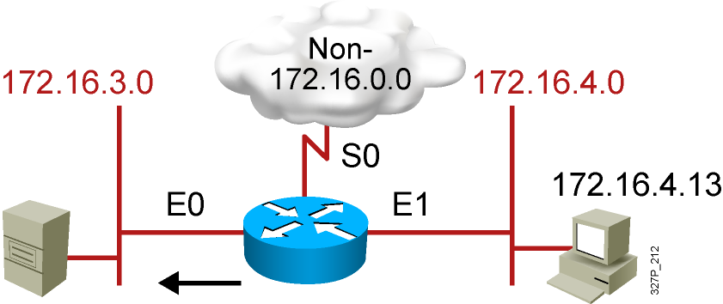
Numbered Extended IPv4 ACL
Example 1
RouterX(config)# access-list 101 deny tcp 172.16.4.0 0.0.0.255 172.16.3.0 0.0.0.255 eq 21
RouterX(config)# access-list 101 deny tcp 172.16.4.0 0.0.0.255 172.16.3.0 0.0.0.255 eq 20
RouterX(config)# access-list 101 permit ip any any
(implicit deny all)
(access-list 101 deny ip 0.0.0.0 255.255.255.255 0.0.0.0 255.255.255.255)
RouterX(config)# interface ethernet 0
RouterX(config-if)# ip access-group 101 out
Deny FTP traffic from subnet 172.16.4.0 to subnet 172.16.3.0 out E0
Permit all other traffic
Notes:
Layer 3 of 3

Slide 11
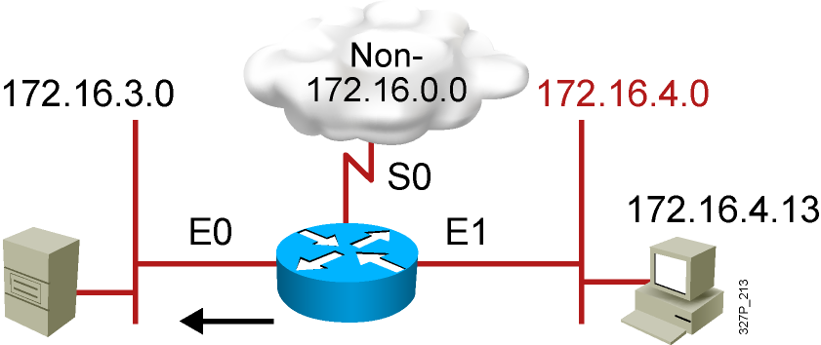
Numbered Extended IPv4 ACL
Example 2
RouterX(config)# access-list 101 deny tcp 172.16.4.0 0.0.0.255 any eq 23
RouterX(config)# access-list 101 permit ip any any
(implicit deny all)
RouterX(config)# interface ethernet 0
RouterX(config-if)# ip access-group 101 out
Deny only Telnet traffic from subnet 172.16.4.0 out E0
Permit all other traffic
Notes:
Layer 3 of 3

Slide 12
Named IP ACL Configuration
RouterX(config)#
ip access-list {standard | extended} name
Alphanumeric name string must be unique
RouterX(config {std- | ext-}nacl)#
[sequence-number] {permit | deny} {ip access list test conditions}
{permit | deny} {ip access list test conditions}
If not configured, sequence numbers are generated automatically starting at 10 and
incrementing by 10
no sequence number removes the specific test from the named ACL
RouterX(config-if)#
ip access-group name {in | out}
Activates the named IP ACL on an interface
Notes:
Layer 3 of 3
Purpose: Layer 3—Finishes with the new form of the access-group command, now able to refer to an IP access list name as well as an access list number.
Emphasize: Introduced with Cisco IOS Release 11.2, named access lists:
Intuitively identify IP access lists using alphanumeric identifiers.
Remove the limit on the number of access lists (previously 99 for IP standard and 100 for IP extended access lists).
Allow per-access-list statement deletions (previously the entire numbered access list needed to be deleted as a single entity).
Require Cisco IOS Release 11.2 or later.

Slide 13
Named Standard IPv4 ACL Example
RouterX(config)#ip access-list standard troublemaker
RouterX(config-std-nacl)#deny host 172.16.4.13
RouterX(config-std-nacl)#permit 172.16.4.0 0.0.0.255
RouterX(config-std-nacl)#interface e0
RouterX(config-if)#ip access-group troublemaker out
Deny a specific host
Notes:
Layer 2 of 2
Emphasize: All hosts on subnet 172.16.4.0 are blocked from going out on E0 to subnet 172.16.3.0.
Note: The red arrows represent the access list is applied as an outbound access list.

Slide 14

Named Extended IPv4 ACL Example
RouterX(config)#ip access-list extended badgroup
RouterX(config-ext-nacl)#deny tcp 172.16.4.0 0.0.0.255 any eq 23
RouterX(config-ext-nacl)#permit ip any any
RouterX(config-ext-nacl)#interface e0
RouterX(config-if)#ip access-group badgroup out
Deny Telnet from a specific subnet
Notes:
Layer 2 of 2
Emphasize: All hosts on subnet 172.16.4.0 are blocked from going out on E0 to subnet 172.16.3.0.
Note: The red arrows represent the access list is applied as an outbound access list.

Slide 15
Commenting ACL Statements
RouterX(config)#
ip access-list {standard|extended} name
Creates a named ACL
RouterX(config {std- | ext-}nacl)#
remark remark
Creates a named ACL comment
Or
RouterX(config)#
access-list access-list-number remark remark
Creates a numbered ACL comment

Slide 16
Monitoring ACL Statements
RouterX# show access-lists {access-list number|name}
RouterX# show access-lists
Standard IP access list SALES
10 deny 10.1.1.0, wildcard bits 0.0.0.255
20 permit 10.3.3.1
30 permit 10.4.4.1
40 permit 10.5.5.1
Extended IP access list ENG
10 permit tcp host 10.22.22.1 any eq telnet (25 matches)
20 permit tcp host 10.33.33.1 any eq ftp
30 permit tcp host 10.44.44.1 any eq ftp-data
Displays all access lists
Notes:
Purpose: This slide introduces the show access-lists command used to verify access lists.
Emphasize: This is the most consolidated method for seeing several access lists.
Note: The implicit deny all statement is not displayed unless it is explicitly entered in the access list.

Slide 17
Verifying ACLs
RouterX# show ip interfaces e0
Ethernet0 is up, line protocol is up
Internet address is 10.1.1.11/24
Broadcast address is 255.255.255.255
Address determined by setup command
MTU is 1500 bytes
Helper address is not set
Directed broadcast forwarding is disabled
Outgoing access list is not set
Inbound access list is 1
Proxy ARP is enabled
Security level is default
Split horizon is enabled
ICMP redirects are always sent
ICMP unreachables are always sent
ICMP mask replies are never sent
IP fast switching is enabled
IP fast switching on the same interface is disabled
IP Feature Fast switching turbo vector
IP multicast fast switching is enabled
IP multicast distributed fast switching is disabled
<text ommitted>
Notes:
240, 197, 102

Slide 18
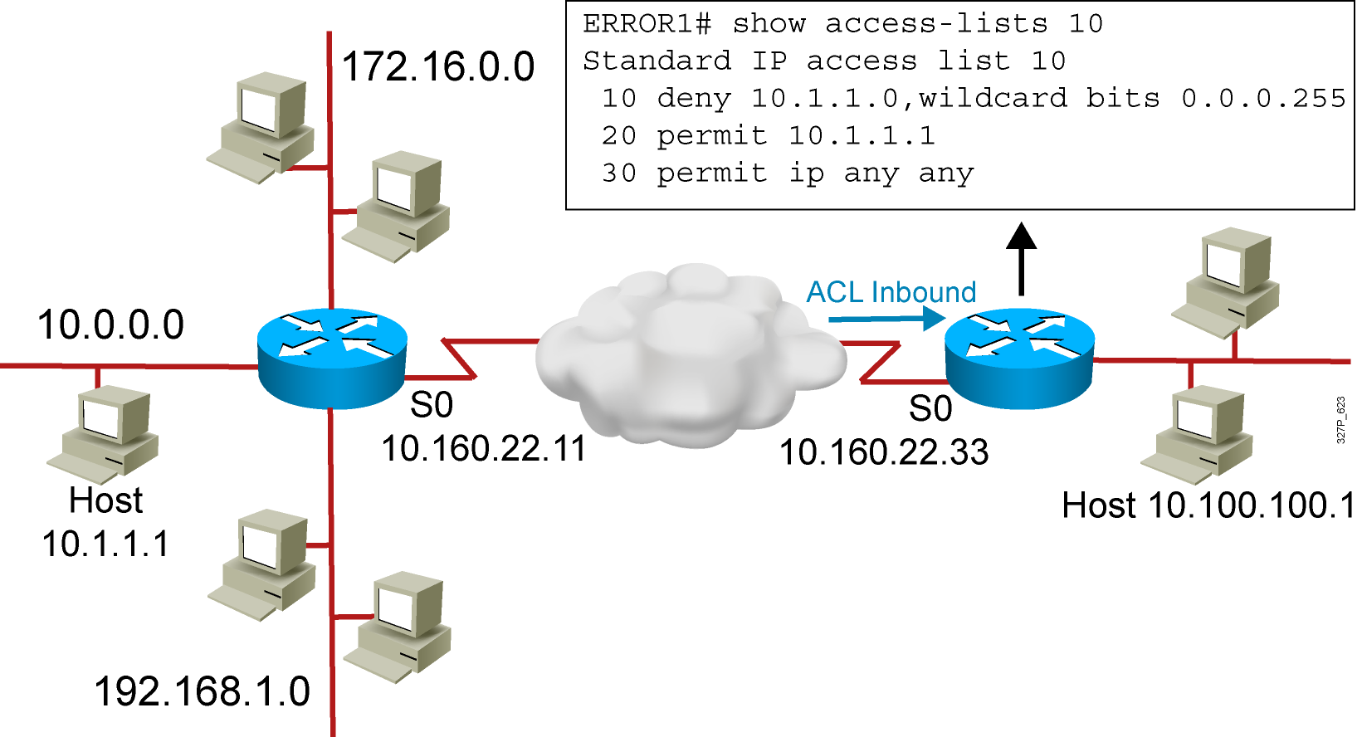
Troubleshooting Common ACL Errors
Error 1: Host 10.1.1.1 has no connectivity with 10.100.100.1.
Notes:
Layer 3 of 3
Purpose: Shows a deny result of the access list test.
Emphasize: Now the packet is discarded into the packet discard bucket. The unwanted packet has been denied access to the outbound interface.
The Notify Sender message shows a process like ICMP, returning an “administratively prohibited” message back to the sender.

Slide 19
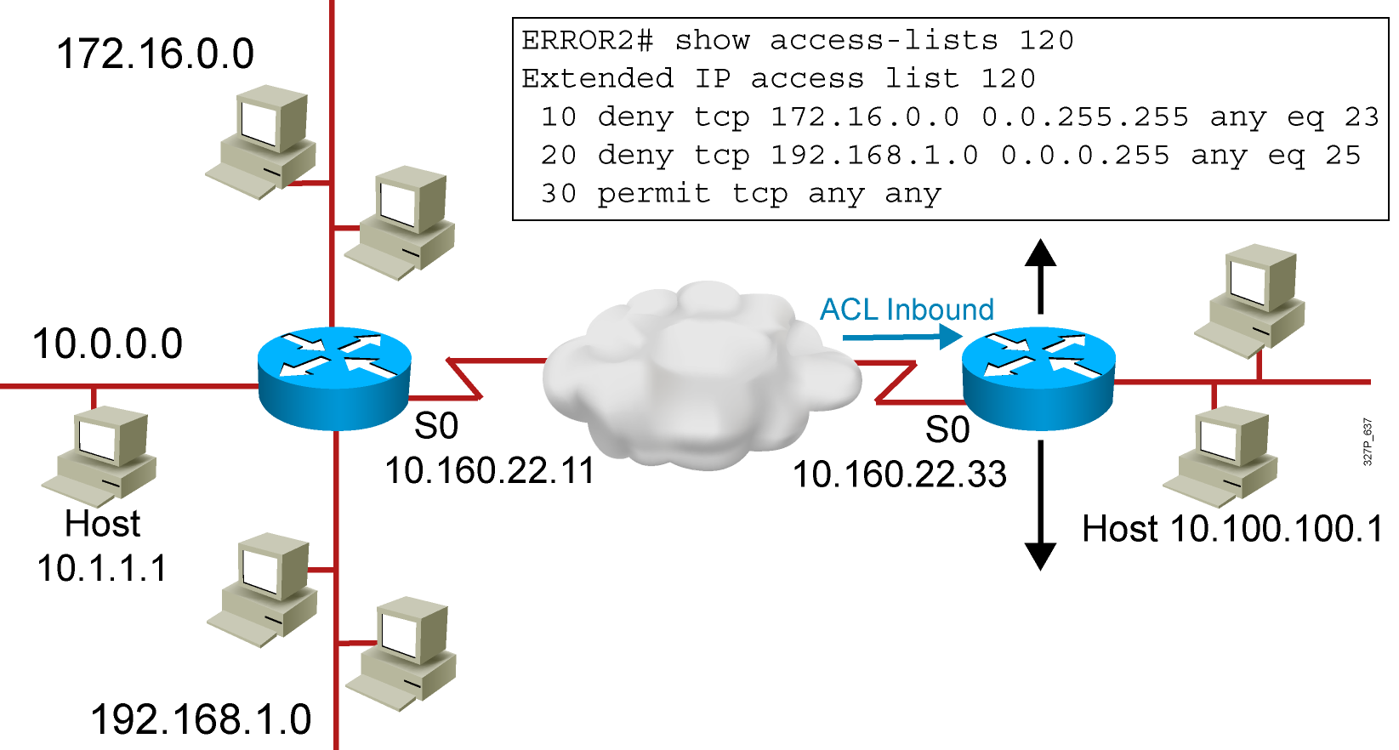
Troubleshooting Common ACL Errors (Cont.)
Error 2: The 192.168.1.0 network cannot use TFTP to connect to
10.100.100.1.
Notes:
Layer 3 of 3
Purpose: Shows a deny result of the access list test.
Emphasize: Now the packet is discarded into the packet discard bucket. The unwanted packet has been denied access to the outbound interface.
The Notify Sender message shows a process like ICMP, returning an “administratively prohibited” message back to the sender.

Slide 20
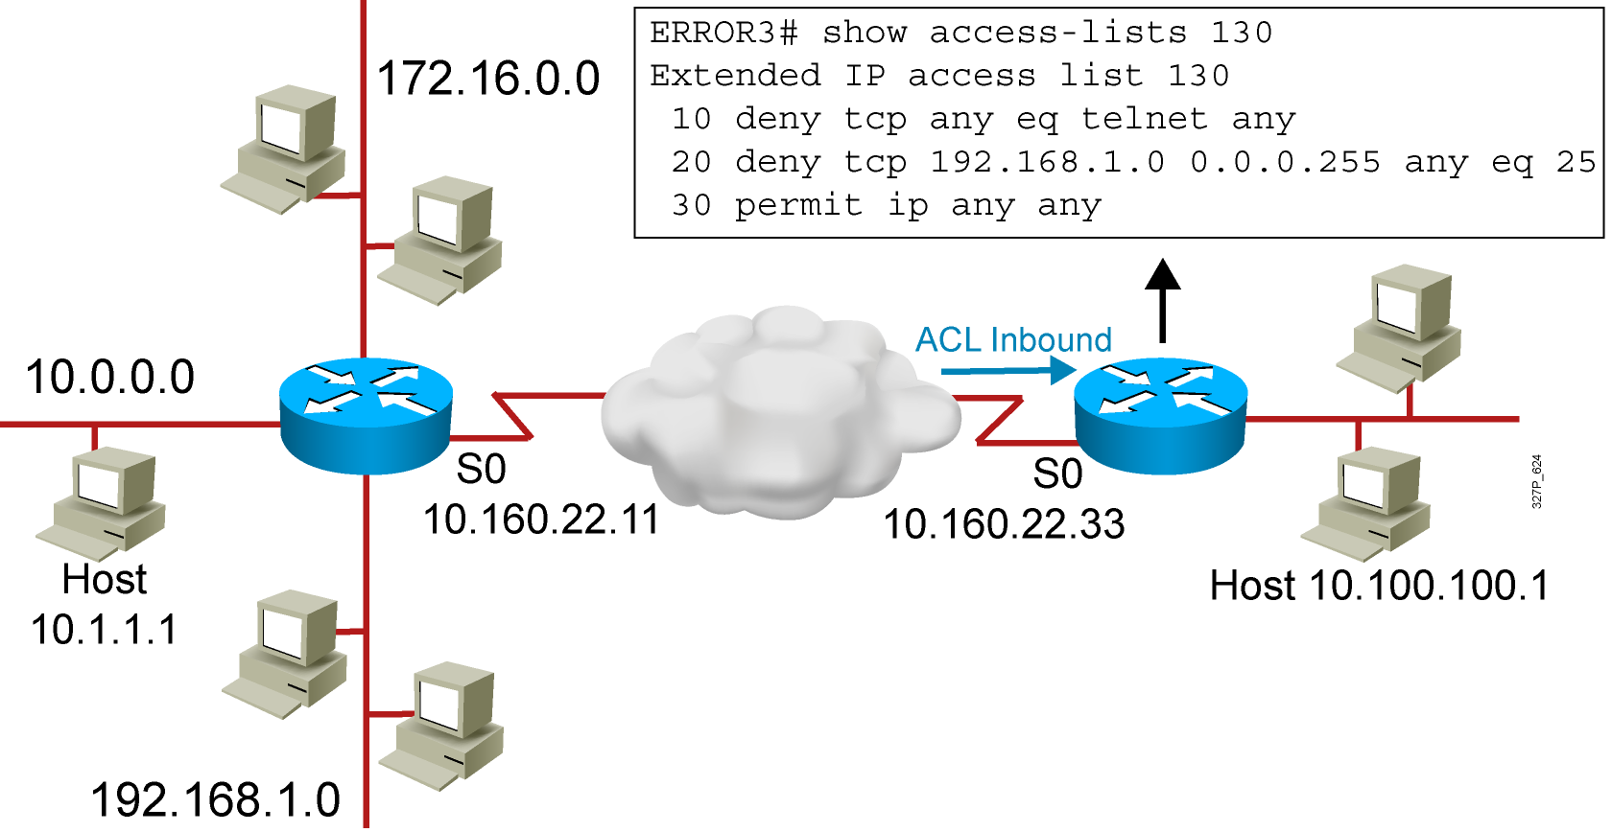
Troubleshooting Common ACL Errors (Cont.)
Error 3: 172.16.0.0 network can use Telnet to connect to 10.100.100.1,
but this connection should not be allowed.
Notes:
Layer 3 of 3
Purpose: Shows a deny result of the access list test.
Emphasize: Now the packet is discarded into the packet discard bucket. The unwanted packet has been denied access to the outbound interface.
The Notify Sender message shows a process like ICMP, returning an “administratively prohibited” message back to the sender.

Slide 21
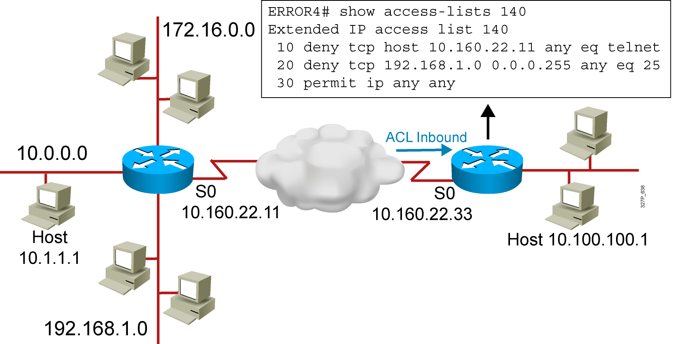
Troubleshooting Common ACL Errors (Cont.)
Error 4: Host 10.1.1.1 can use Telnet to connect to 10.100.100.1,
but this connection should not be allowed.
Notes:
Layer 3 of 3
Purpose: Shows a deny result of the access list test.
Emphasize: Now the packet is discarded into the packet discard bucket. The unwanted packet has been denied access to the outbound interface.
The Notify Sender message shows a process like ICMP, returning an “administratively prohibited” message back to the sender.

Slide 22
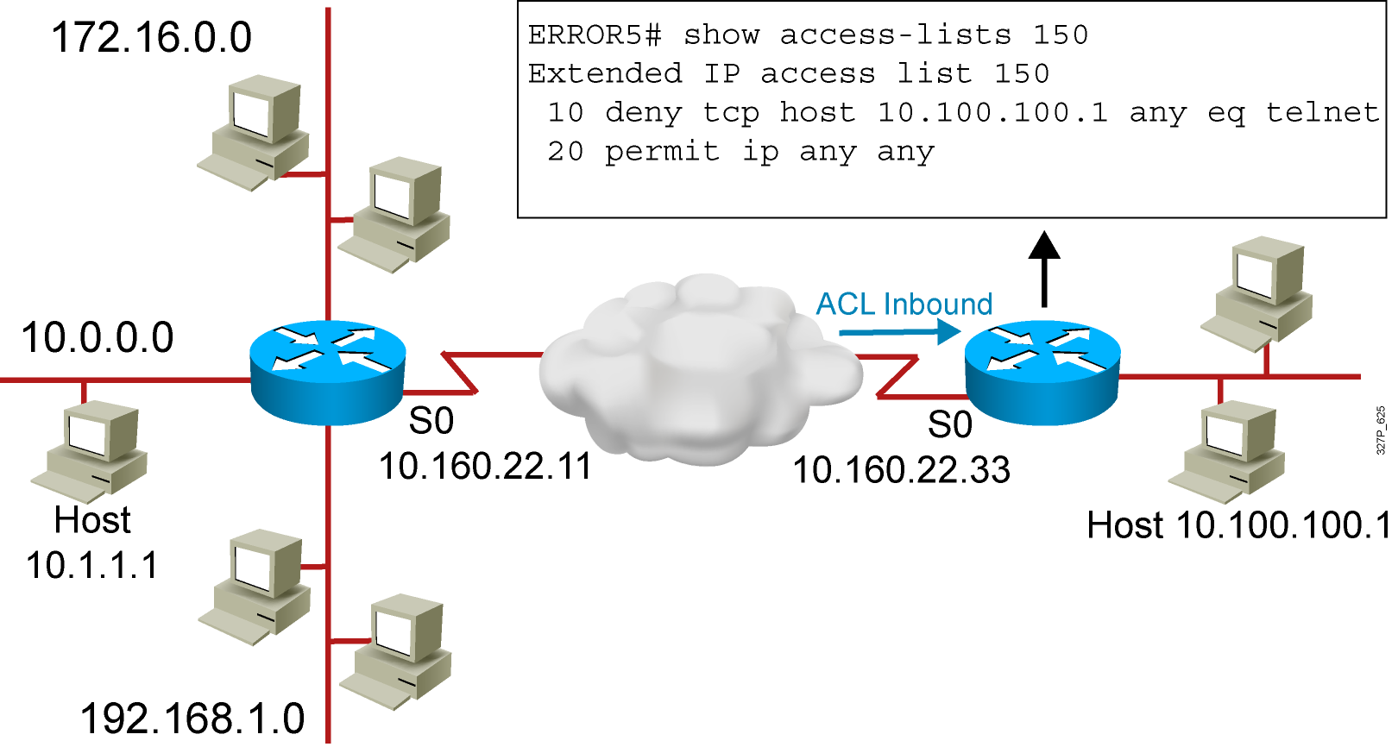
Troubleshooting Common ACL Errors (Cont.)
A
B
Error 5: Host 10.100.100.1 can use Telnet to connect to 10.1.1.1,
but this connection should not be allowed.
Notes:
Layer 3 of 3
Purpose: Shows a deny result of the access list test.
Emphasize: Now the packet is discarded into the packet discard bucket. The unwanted packet has been denied access to the outbound interface.
The Notify Sender message shows a process like ICMP, returning an “administratively prohibited” message back to the sender.

Slide 23
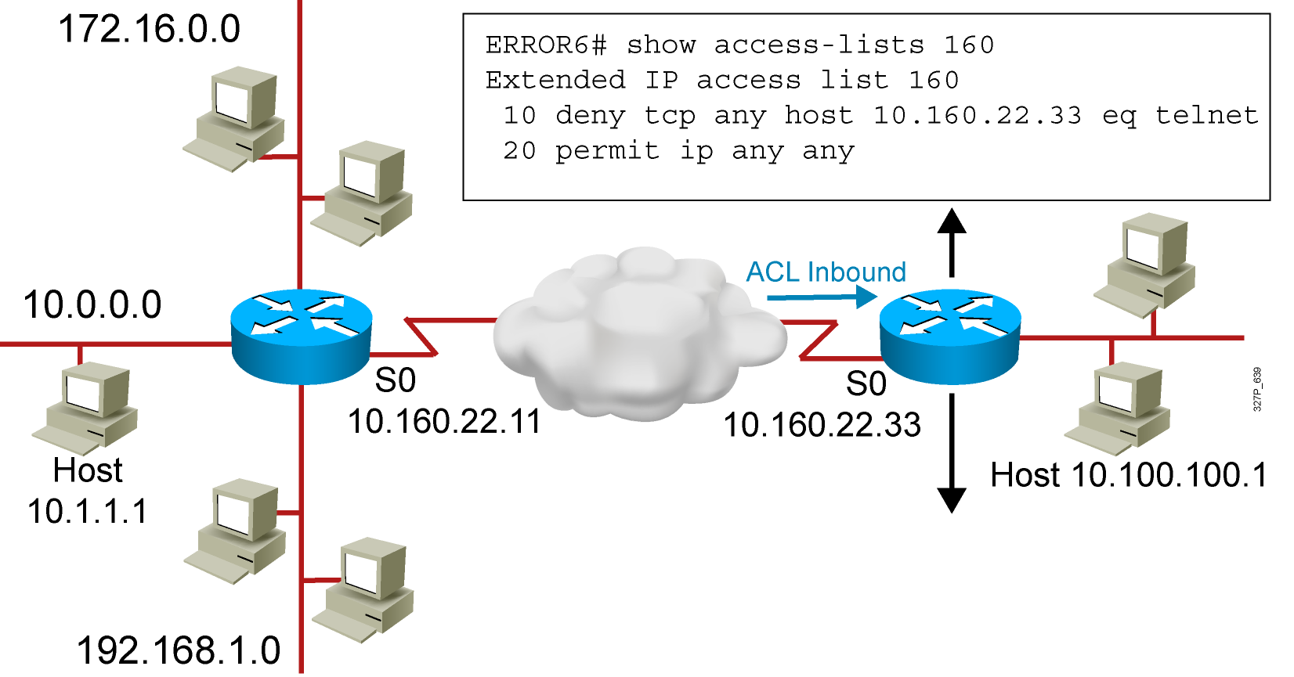
Troubleshooting Common ACL Errors (Cont.)
  A
  B
Error 6: Host 10.1.1.1 can use Telnet to connect into router B, but this connection should not be allowed.
Notes:
Layer 3 of 3
Purpose: Shows a deny result of the access list test.
Emphasize: Now the packet is discarded into the packet discard bucket. The unwanted packet has been denied access to the outbound interface.
The Notify Sender message shows a process like ICMP, returning an “administratively prohibited” message back to the sender.

Slide 24
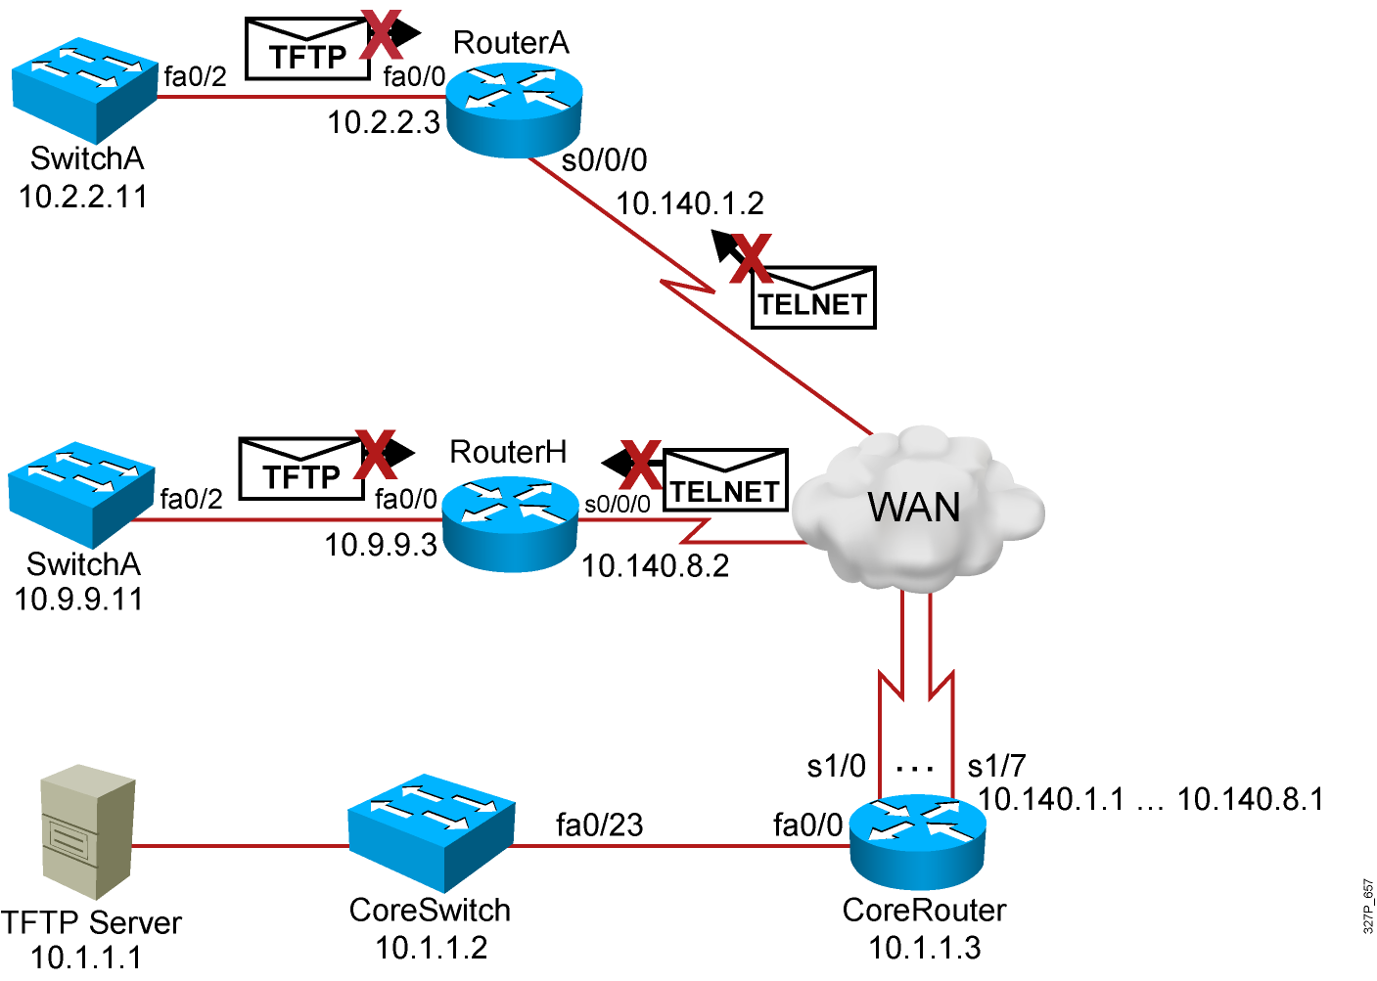
Visual Objective 6-1: Implementing and Troubleshooting ACLs
WG Router s0/0/0 Router fa0/0 Switch
A 10.140.1.2 10.2.2.3 10.2.2.11
B 10.140.2.2 10.3.3.3 10.3.3.11
C 10.140.3.2 10.4.4.3 10.4.4.11
D 10.140.4.2 10.5.5.3 10.5.5.11
E 10.140.5.2 10.6.6.3 10.6.6.11
F 10.140.6.2 10.7.7.3 10.7.7.11
G 10.140.7.2 10.8.8.3 10.8.8.11
H 10.140.8.2 10.9.9.3 10.9.9.11
SwitchH
Notes:
Lab 13 ACL
Note: Refer to the lab setup guide for lab instructions.

Slide 25
Summary
  Standard IPv4 ACLs allow you to filter based on source IP address.
  Extended ACLs allow you to filter based on source IP address, destination IP address, protocol, and port number.
  Named ACLs allow you to delete individual statements from
  an ACL.
  You can use the show access-lists and show ip interface commands to troubleshoot common ACL configuration errors.

